Slide 1

MuscleQuant AI :
AI- ASSISTED MUSCLE OBSERVATION
Delivered to : Professor Ahmed Banafa
Designed By - Keshav harit
DESIGNED BY - KESHAV HARIT

Slide 2

TEAM MEMBERS AND ROLES
FAHIM SHAHRIAR
KESHAV HARIT
GELIN DENG
HARDWARE ASSEMBLY &
INTEGRATION
BACKEND PROGRAMMER
QA SPECIALIST
FRONTEND PROGRAMMER
CLOUD OPERATIONS SPECIALIST
DATABASE SPECIALIST
AI INTEGRATION SPECIALIST
Designed By - FAHIM SHAHRIAR

Slide 3
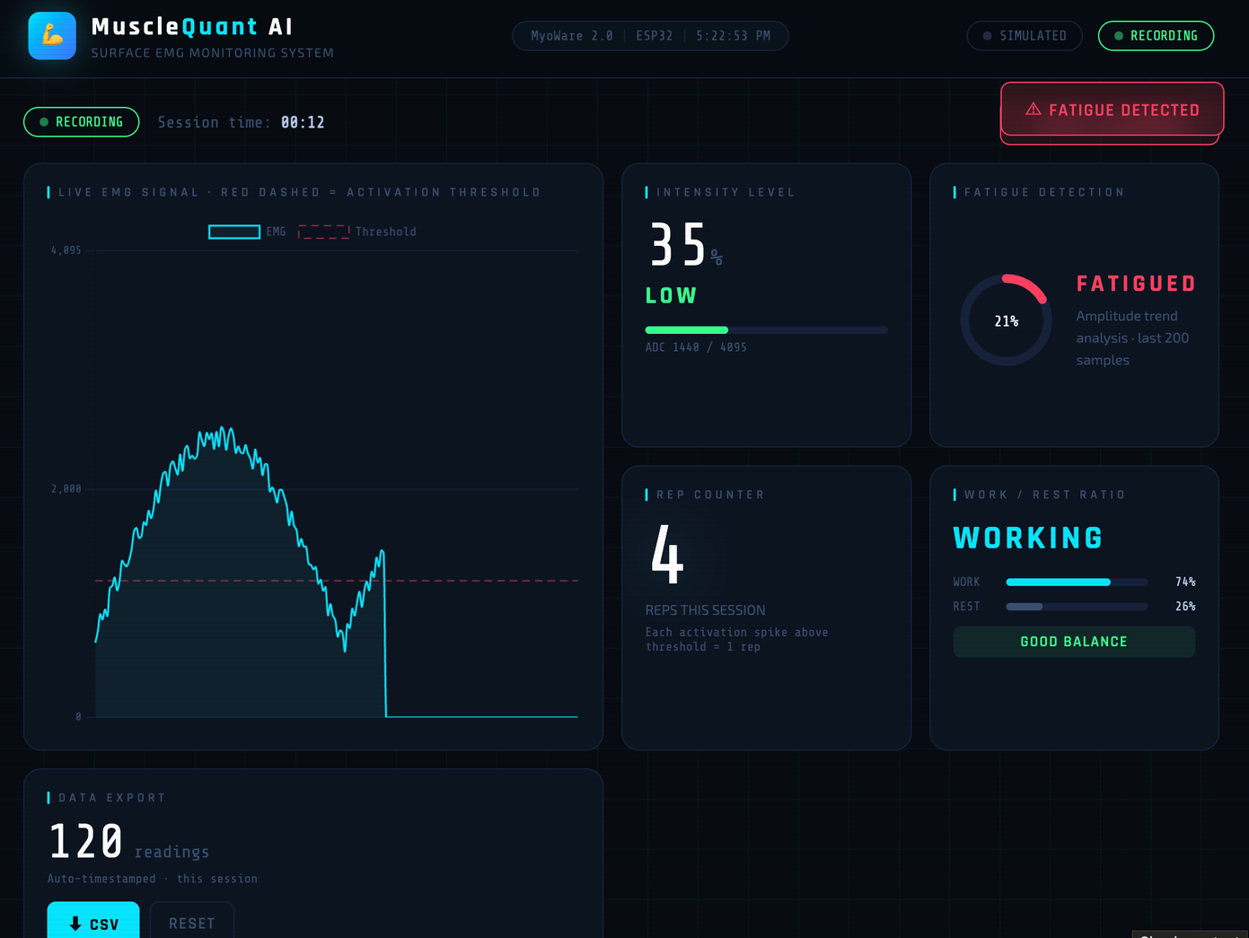
Frontend dashboard basic UI development
• Real-time EMG visualization prototype
features :
Intensity Level — Real-time muscle activation strength classified as Rest, Low, Moderate, or High
Fatigue Detection — Monitors signal amplitude drop over time to detect muscle fatigue onset
Rep Counter — Counts repetitions automatically each time muscle activation crosses the threshold
Work / Rest Ratio — Tracks total time spent active vs resting and flags imbalance during workout
Designed By keshav harit

Slide 4
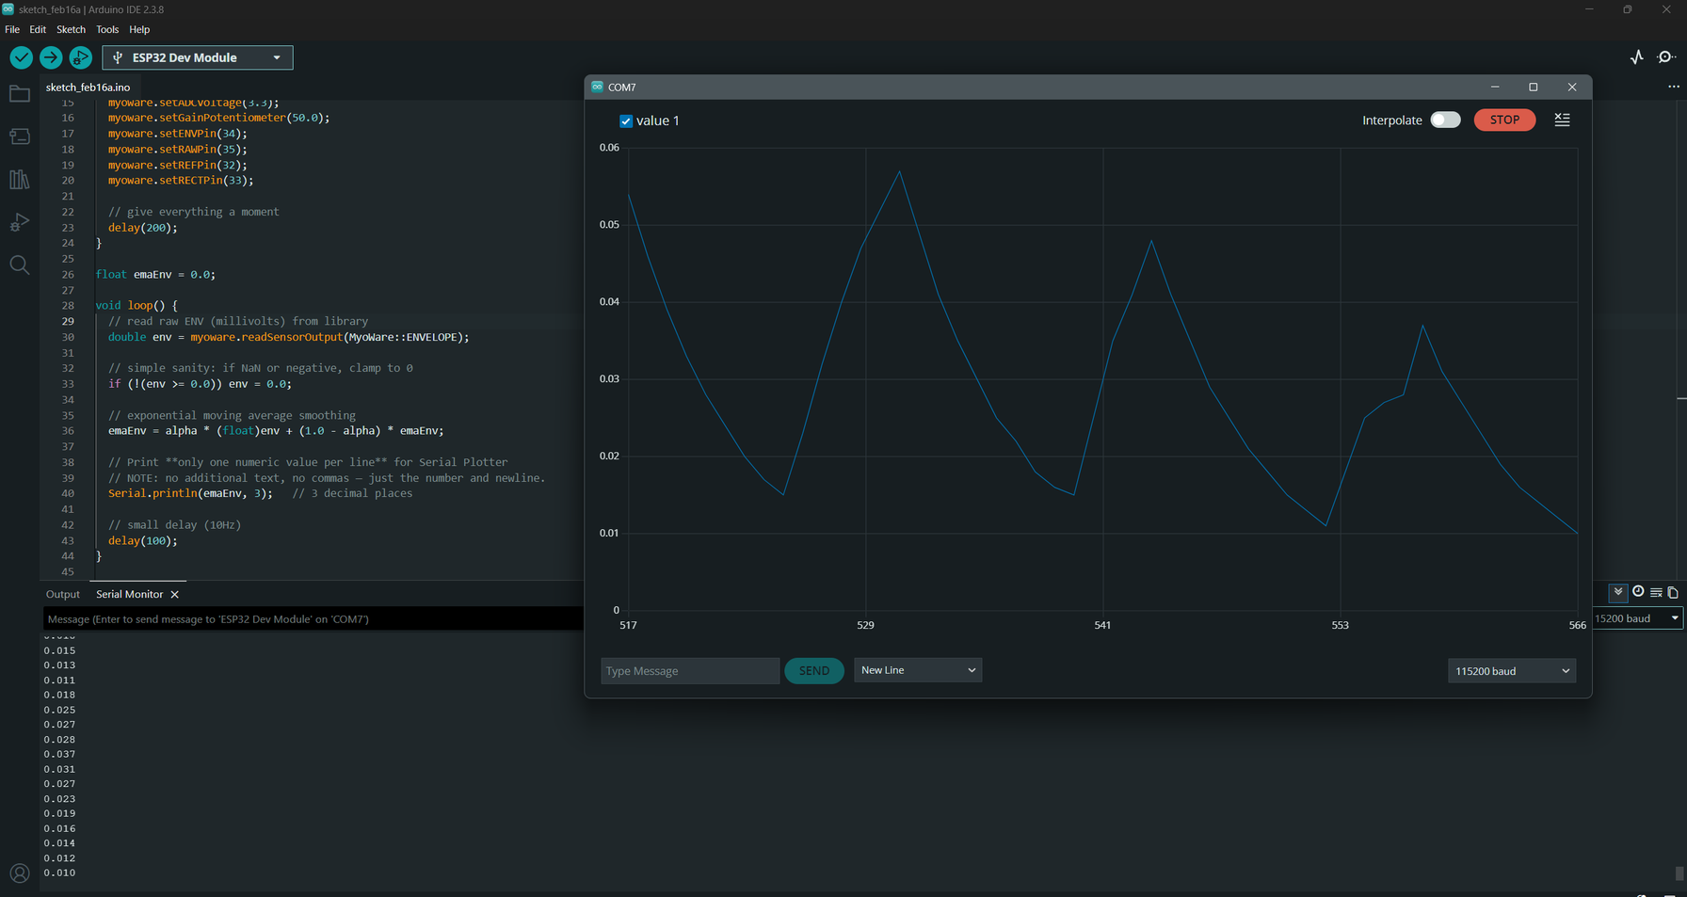
PROGRESS – BACKEND DESIGN
EMG SIGNALS
Designed By - FAHIM SHAHRIAR

Slide 5
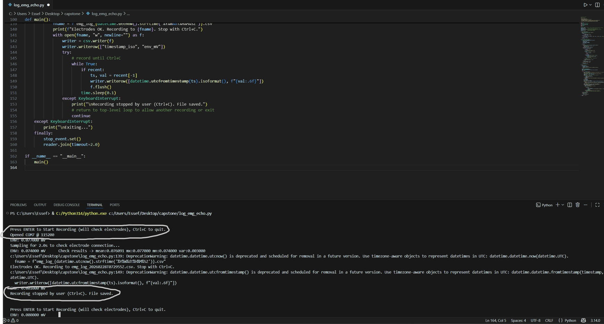
PROGRESS – BACKEND DESIGN
BACKEND CODE
Designed By - FAHIM SHAHRIAR

Slide 6
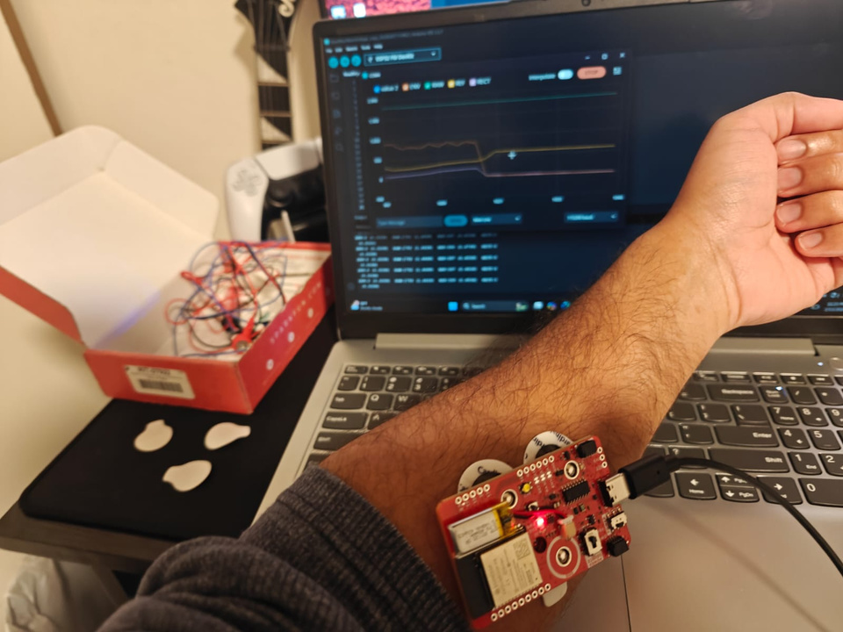
PROGRESS OVERVIEW
HARDWARE ACQUISITION
DRIVER INSTALLATION
PC INTEGRATION
SIGNAL TRANSMISSION
BACKEND CODE
FEATURE EXTRACTION
DATA EXPORT METHOD
Designed By - FAHIM SHAHRIAR

Slide 7
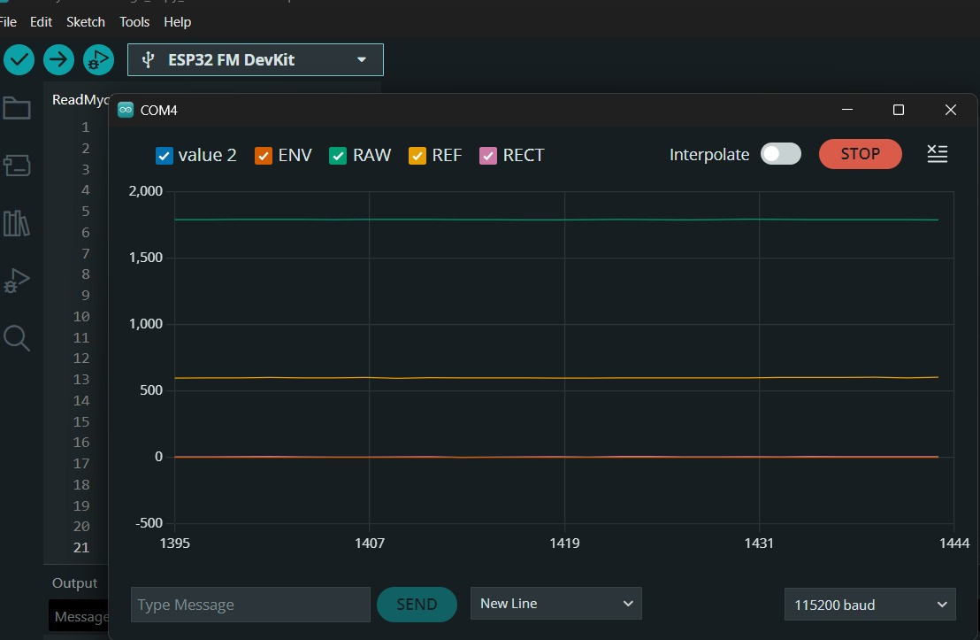
FACED CHALLENGES
PREVIOUS
Drivers automatically deleted (Solved)
Unstable Connection (Solved)
Wireless module not connecting (In progress)
Plotter not giving consistent frequencies (In progress)
Exporting data method (Solved)
CURRENT
FRONT END - BACKEND INTEGRATION (In progress)
DATABASE DESIGN (In Progress)
Designed By - FAHIM SHAHRIAR

Slide 8
WHATS NEXT ?
SOLVING ALL THE CURRENT CHALLENGES
CONTINUE WRITING BACK-END PROGRAM FOR THE FEATURES
DESIGN FRONTEND AND CONNECT TO BACKEND
DESIGN DATABASE
Designed By - FAHIM SHAHRIAR

Slide 9
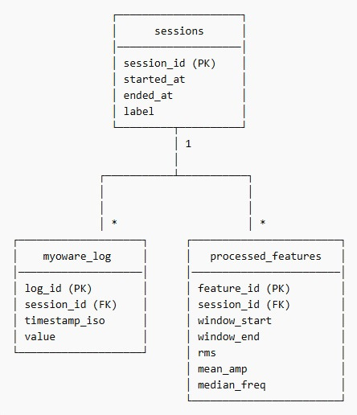
DATABASE DESIGN (TABLES & PURPOSE)
Purpose:
1. Sessions
• Represents one recording session or workout
• Groups EMG signals into meaningful time segments
• Stores metadata such as start time, end time, and label
2. Myoware_Log (Raw Data)
• Stores raw EMG signals directly from the device
• Contains timestamp and muscle activation value
• Linked to sessions for structured analysis
• Preserves original data for integrity and auditing
3. Processed_Features
• Stores extracted features per time window
• Examples: RMS, mean amplitude, median frequency
• Used for visualization and machine learning
• Avoids repeated computation of signal features
• One session can contain many raw EMG samples
• One session can generate many processed feature records
• Processed features are computed from raw EMG data
This design separates raw signal storage, session grouping, and feature extraction, ensuring scalability, data integrity, and AI readiness.
Designed By - GELIN DENG

Slide 10
Project Timeline
Phase 3: Development (Weeks 7–10)
Phase 4: Testing & Refinement (Weeks 11–13)
Phase 1: Scope
(Weeks 1–3)
Phase 2: Design (Weeks 4–6)
Week 4
System Design, Hardware setup and inspection
Sensor and wireless module configuration
Week 11
• Backend testing
• Database performance testing
Week 1
Group selection & initial research
Week 7
• Backend initial setup
• API structure design
Week 10
• Cloud service setup (Firebase / GCP / AWS)
• Backend deployment to cloud
• Connect frontend to backend APIs
Week 2
Topic Selection and submission of selected topic
Week 5
Fix remaining challenges with hardware and design program architecture and frameworks
Week 8
• Frontend dashboard basic UI development
• Real-time EMG visualization prototype
Week 13
• Frontend UI refinement
• Cloud deployment testing
• System integration testing
Week 3
Requirement analysis
System planning and task distribution
Week 12
• Final integration (Frontend + Backend + DB + Cloud)
• End-to-end system validation and testing
Week 6
• Frontend and Backend architecture planning
• Database schema design (raw_samples, processed_features, predictions)
• Cloud deployment planning
Week 9
• Database implementation (tables & storage logic)
• Backend integration with database
Designed By - Keshav harit

Slide 11
REFERENCES
[1] R. Merletti and D. Farina, Surface Electromyography: Physiology, Engineering and Applications. Hoboken, NJ, USA: Wiley-IEEE Press, 2016.
[2] C. J. De Luca, “The use of surface electromyography in biomechanics,” J. Appl. Biomech., vol. 13, no. 2, pp. 135–163, 1997.
[3] A. Phinyomark, P. Phukpattaranont, and C. Limsakul, “Feature reduction and selection for EMG signal classification,” Expert Syst. Appl., vol. 39, no. 8, pp. 7420–7431, 2012.
[4] R. H. Chowdhury et al., “Surface electromyography signal processing and classification techniques,” Sensors, vol. 13, no. 9, pp. 12431–12466, 2013.
[5] M. A. Oskoei and H. Hu, “Myoelectric control systems—A survey,” Biomed. Signal Process. Control, vol. 2, no. 4, pp. 275–294, 2007.
[6] I. Goodfellow, Y. Bengio, and A. Courville, Deep Learning. Cambridge, MA, USA: MIT Press, 2016.
Designed By - Keshav harit

